Slide 1
Sitemap, Storyboard and Wireframe
Lim Shuyi

Slide 2
Site Map: Hierarchical
Home
Menu
Music
Jobs

Slide 3
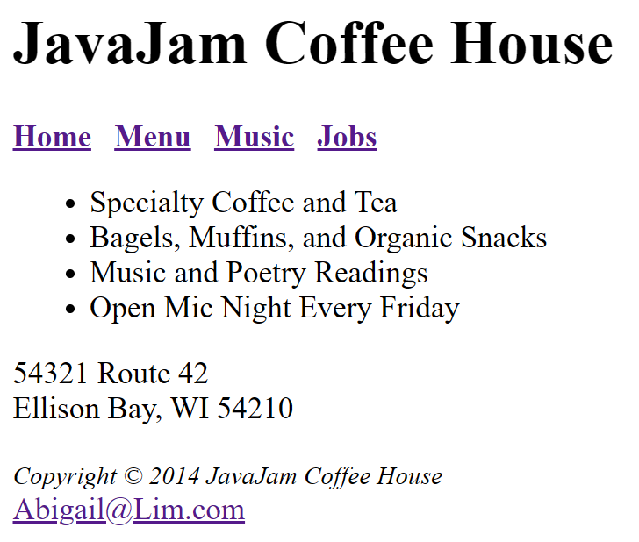
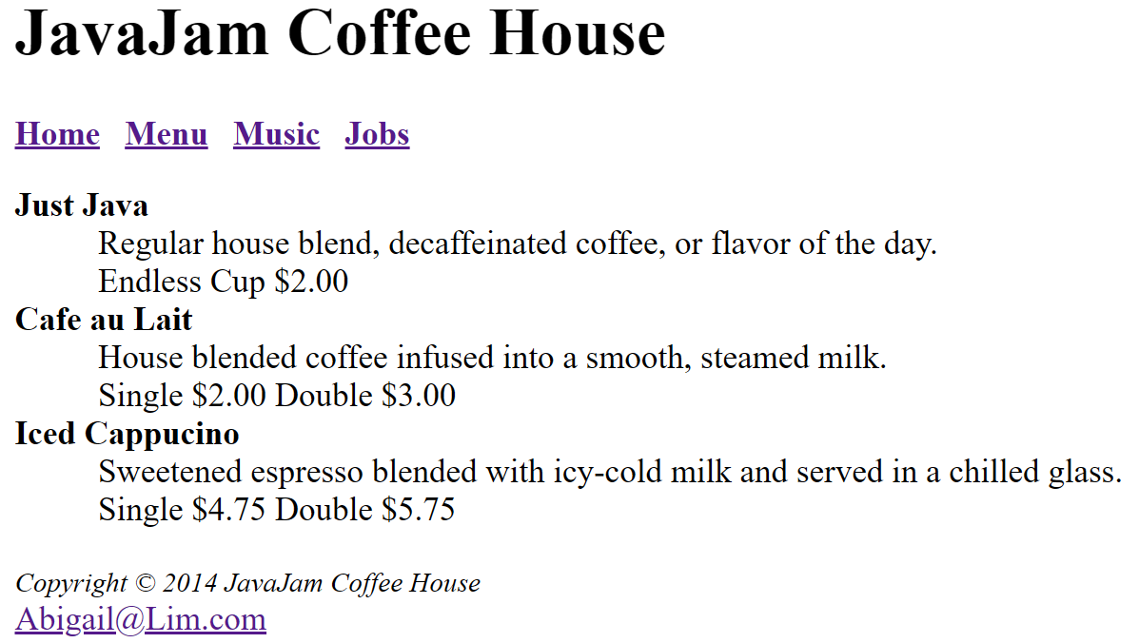
Storyboard
Music & Jobs still in the making
Customers will enter the JavaJam Coffee House website and see the home page. Home page contains more information about the coffee house and also address s they can find their way there
Customers can click on the Menu button to see the menu which also indicates the price and size

Slide 4
Wireframe
Home page
JavaJam Coffee House
All Pages will have title and nav bar
Home
Menu
Music
Jobs
More info about JavaJam Coffee House
Content
Address
Copyright & Contact
All Pages will have copyright & contact as footer

Slide 5
Wireframe
Home page
JavaJam Coffee House
Header
Home
Menu
Music
Jobs
Navigation
More info about JavaJam Coffee House
Content
Address
Copyright & Contact
Footer

